Slide 1
Pilot Review and Proposed Extensions
Internal Only

Slide 2

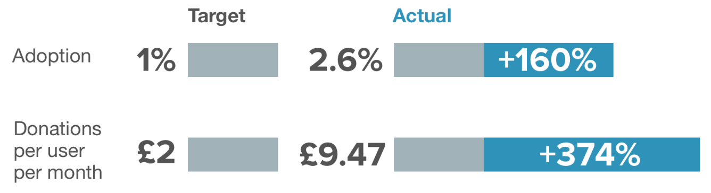
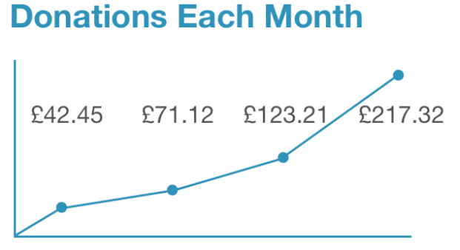
Barclays Roundup has been live for approaching 5 months, launched initially in January and then updated in March. Email comms were targeted at UK Citizenship Ambassadors and other warm networks, supported by a Barclays Now story at the end of Q1.
v1.1
Launched January 17th
10 charities
6 banks included
Updated March 31st
43 charities (plus portfolio option)
9 banks included
v1.2
Feb Mar Apr May
The first phase of the pilot has largely been successful, with all technical bugs corrected. Initial targets set have been exceeded, and the conversion from initial sign up to full user has been excellent. Total monthly donations are growing MoM.

Slide 3
Over the next few months we will continue to drive signups, particularly through non-digital channels, focusing on key colleague events such as the Citizenship Ambassador Summit, using face time with colleagues to create awareness and convert existing users to net-promoters.
v1.3
A final phase1 update is timetabled for Q3
Add additional charities in line with user preferences
Improve regular communications and feedback loop with existing users
Simultaneously, we would like to explore proposed extensions to the pilot proposition, based on the feedback that we’ve received, unexpected consequences and noted limitations of the pilot:
+
40+ charities have approached Barclays and Bstow looking for ways in which they can actively be more involved with the product and use it for fundraising (Marie Curie, Bloodwise, Prince’s Trust)
-
No commercial return for Barclays during pilot; benefits more intangible at this stage, i.e. positive brand reputation and colleague engagement.
Given the success of the pilot trial and points above, we think there’s a good opportunity to build upon the foundation we have, engage key charity partners more closely, and add elements which generate a commercial return for Barclays.

Slide 4
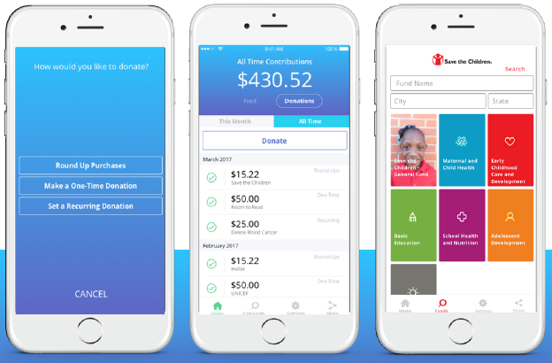
Proposed extension v2 – Barclays Roundup (B2B)
By enhancing the existing version of Barclays Roundup into a white-labelled mobile app, we can create an attractive fundraising proposition for key charity partners and clients, using the Roundup functionality. The charities can then market a branded version to their donor base as a new or alternative way to donate. The unbranded app can also replace the desktop version of Barclays Roundup for colleagues to continue donating.
As well as giving charities their own version of Roundup, importantly, the B2B extension allows us to trial a different business model and generate new revenue streams for Barclays in three ways:
1
Transaction fees from donations
2
Commercial opportunities by acquiring large charities as clients
3
Commercial opportunities by selling solution to SME charities

Slide 5

1
Transaction fees from donations
A proposed change to Bstow’s fee structure would allow an opportunity for Barclays to acquire a share of revenue generated:
Usage costs to charities
Fees taken from donations
Bstow fee 5%
Prism Gift fund f ee 5%
Stripe payment processing fee 1.4% (+ 20p)
Current
v1 model
Free
v1
Future
v2 model
Free
Bstow fee 2.5%
(0.5% to Barclays)
v2
For the B2B version, Bstow would take 2.5% of each donation as a fee to
cover transaction costs, and pass on 0.5% to Barclays (paid quarterly)

Slide 6

The commercial opportunity here is outlined below using
Cancer Research UK as an example (and a potential trial B2B user)
c. 1 million donors
c. £ 400 million income (as of Nov 2016)
Donation per user (per month) | Take up/conversion rate
 |  | 2% | 5% | 10% | 25%
 | £5 | 6,000 | 15,000 | 30,000 | 75,000
 | £10 | 12,000 | 30,000 | 60,000 | 150,000
 | £15 | 18,000 | 45,000 | 90,000 | 225,000
 | £20 | 24,000 | 60,000 | 120,000 | 300,000
If CRUK converted 25% of their £20 per month donors to using Barclays Roundup, then Barclays would generate £300K in fees annually
Barclays income
potential
(0.5% of Bstow fee)

Slide 7
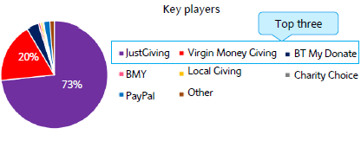



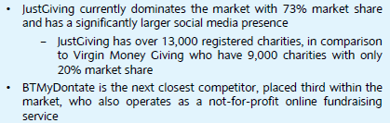
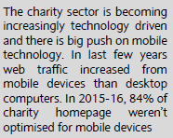
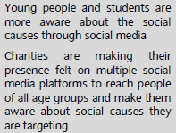


This fee structure is also more in line with the main three online fundraising competitors in the UK, making Barclays Roundup v2 a more attractive proposition for both charities and users:
Usage costs to charities
Fees taken from donations
Monthly subscription
£15 + VAT
(<£15K donations)
£39 + VAT
(>£15K donations)
JustGiving fee 5%
Card processing fee 1.25%
(or 1.45% Paypal)
Setup fee
£100 + VAT
Transaction fee 2%
Card processing fee 1.45%
(or 1.6% Paypal/Amex)
Free
Processing fee 13-15p
(debit/credit card)
v2
Free
Bstow fee 2.5%
(0.5% to Barclays)
The B2B solution also helps charities with two of the biggest barriers that prevent a greater volume of online donations:
v2

Slide 8
2
Commercial opportunities by acquiring large charities as clients
Acquiring large charities as Barclays clients is commercially attractive, and offering Barclays Roundup as an free incentive to support fundraising is a USP
Income from charities can be derived in three ways:
Charity on-boarding and the fees associated for banking a charity – deposits, money transmission, FX, debt
Cross selling products which we can offer the charity – Barclaycard commercial cards and acquiring, asset finance, wealth/investment
Payment processing fees and the derived income
£100k
Approx average annual income derived from acquiring and banking a top 100 large charity
If Barclays Roundup v2 product was offered to new, large charity clients without any setup fees then this could be an attractive incentive in any acquisition talks

Slide 9
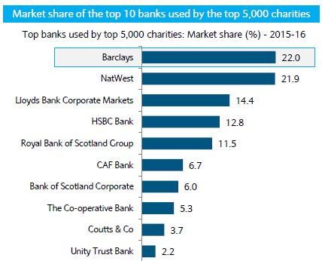
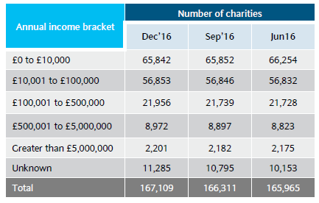


There is an excellent commercial opportunity given the scale of the UK market and appetite of the organisation to grow working with large charitable clients
As well as holding relationships with 22% of the Top 5,000 charities, Barclays is also the main banker to 32% of the Top 100 charities, and has relationships with 74% of this subsector.
Income growth expected to almost double

Slide 10
As corporate customers begin at £6.5m income levels, and the Top 100 charities are likely to sit in the £5m+ income bracket, then it’s a fair assumption to suggest we bank approximately 704 of the 2,201 UK charities with an annual income above £5m.
Therefore we have an opportunity to acquire up to 1497 of the £5m+ charities in the UK as full customers, with an approx average annual value to Barclays of £100k.
Scale Size Opportunity
1497 x £100k = £149.7m
Charities Annual Income Annual Total
Additionally, if each of these charities were to switch 2% of their existing donors to the Barclays Roundup platform, donating an average of £10 a month (akin what have seen in our pilot to date) then the fee income would amount to £12,000 per charity. Therefore, for fee and acquisition income, the total opportunity is:
£18m + £149.7m = £167.7m
Fee Income Acquisition Income Annual Total

Slide 11
3
Commercial opportunities by selling solution to SME charities
Problems and Opportunities
Acquiring small and medium sized charities as clients isn’t as commercially attractive to Barclays as large charities, yet the volume of charities with a turnover of less than £100k per annum accounts for 73% of UK charities (122,695 in total)
Volume
Both the desire to, and need for, digital engagement with fundraising activities is vital for SME charitable causes, but SME charities would struggle to realise a ROI on investing in digital app/platform development, and so rely on unbranded solutions and subscription costs just to be added to online donation platforms.
Scalable
Solutions
Reputation
SME charity relationships with donors & their local community are often much stronger than larger charities, and their donors are both passionate fundraisers and positive net promoters of their work.
Relationship Building
Majority of enquiries for future engagement with Barclays Roundup following pilot has been from the SME charity space.

Slide 12
Solution
A branded app for SME charities, powered by Barclays Roundup , for a low set up and monthly subscription cost
Charity benefits
A personalised digital fundraising and donation acquisition service. Competitively priced.
Fees for product and transactions.
Campaign promotion and product adoption handled largely by SME charities and their existing supporters.
Net promotion of Barclays and brand halo effect.
Barclays benefits
Example assumption: £100 setup fee + £25 p/m subscription fee; 5% adoption rate
Scale Size Opportunity
6135 x (£100 + £300) = £2.45m
+ transaction fees
Charities Setup + Monthly Fees (x 12) Total

Slide 13
Proposed pilot extension deliverables – v2.1
A ‘Bstow powered by Barclays’ mobile app for colleagues to Roundup donations to existing charities. This product will form the basis of the mobile app given for charity clients to trial, albeit unbranded.
A branded app for Cancer Research UK or other large charity to trial and market to a small pool of their donors. The charity and teams within Barclays have been engaged with previously and are keen to be actively involved in expansion plans.
If successful then roll out to a further nine existing charity clients (clients TBC)
Time to implement v2.1.1 and 2.1.2 : 90 days
Cost to implement v2.1: £50,000
Future plans for v2.2 – SME product tested with Barclays local charities

